Slide 1
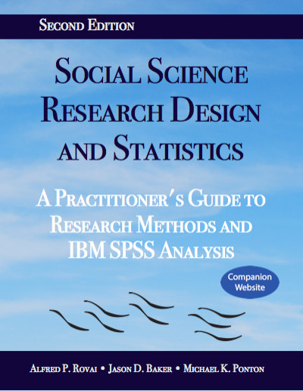
Social Science Research Design and Statistics, 2/e
Alfred P. Rovai, Jason D. Baker, and Michael K. Ponton
Independent-Samples T-Test
PowerPoint Prepared by
Michael K. Ponton
IBM® SPSS® Screen Prints Courtesy of International Business Machines Corporation,
© International Business Machines Corporation.

Slide 2
Uses of the Independent-Samples T-Test
Test the hypothesis that there is no difference between the population means (μ) of two independent groups.
Establish an estimate (i.e., a confidence interval) for the difference between the two population means.

Slide 3
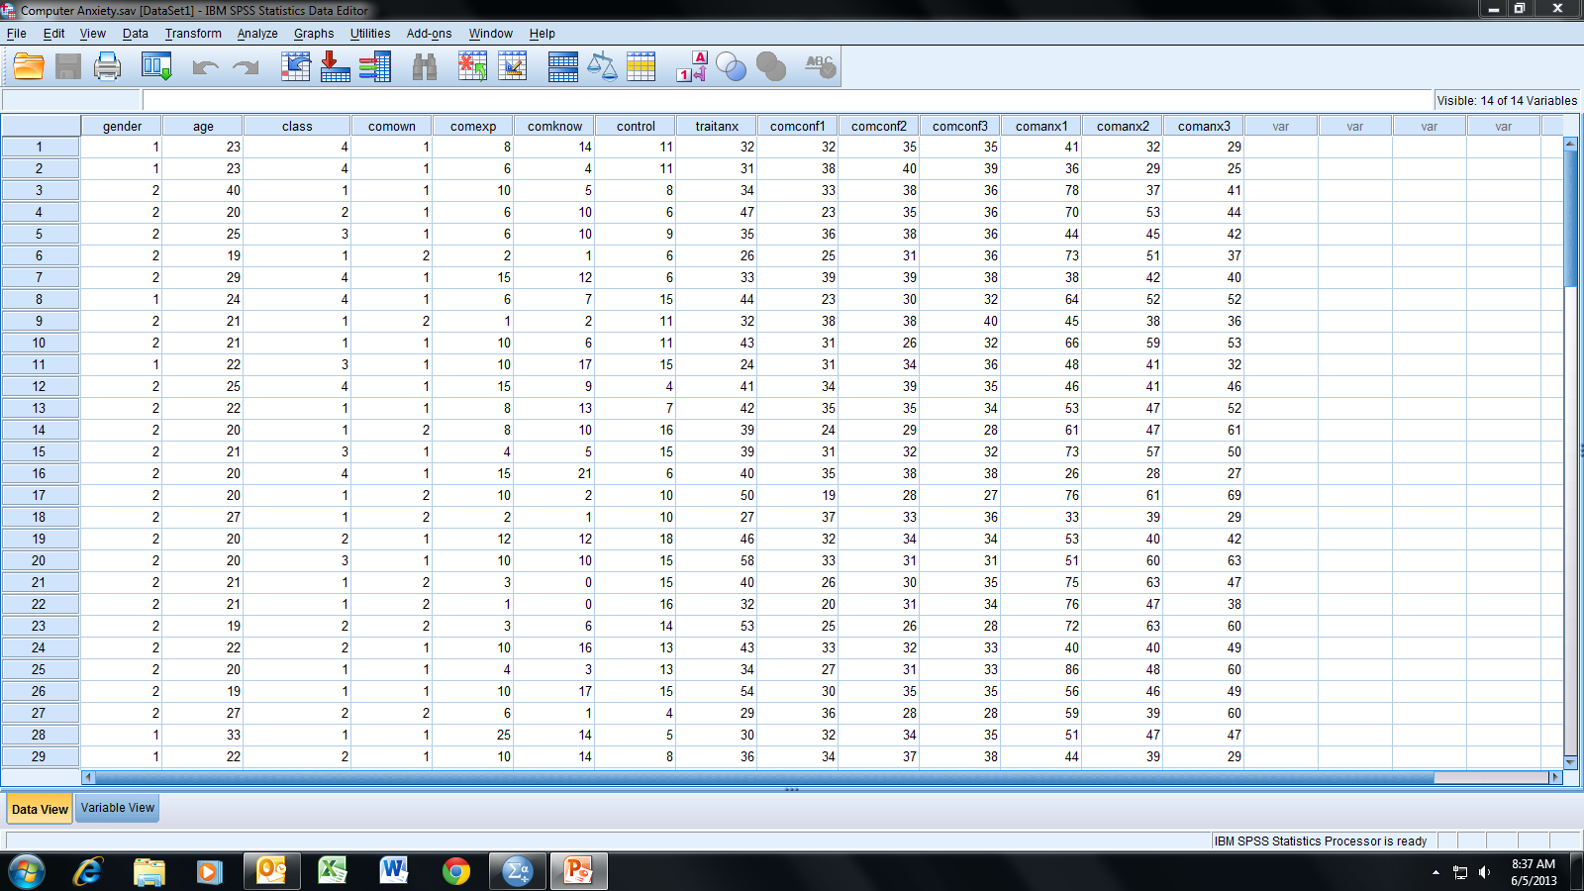
Open the dataset Computer Anxiety.sav.
File available at http://www.watertreepress.com/stats

Slide 4
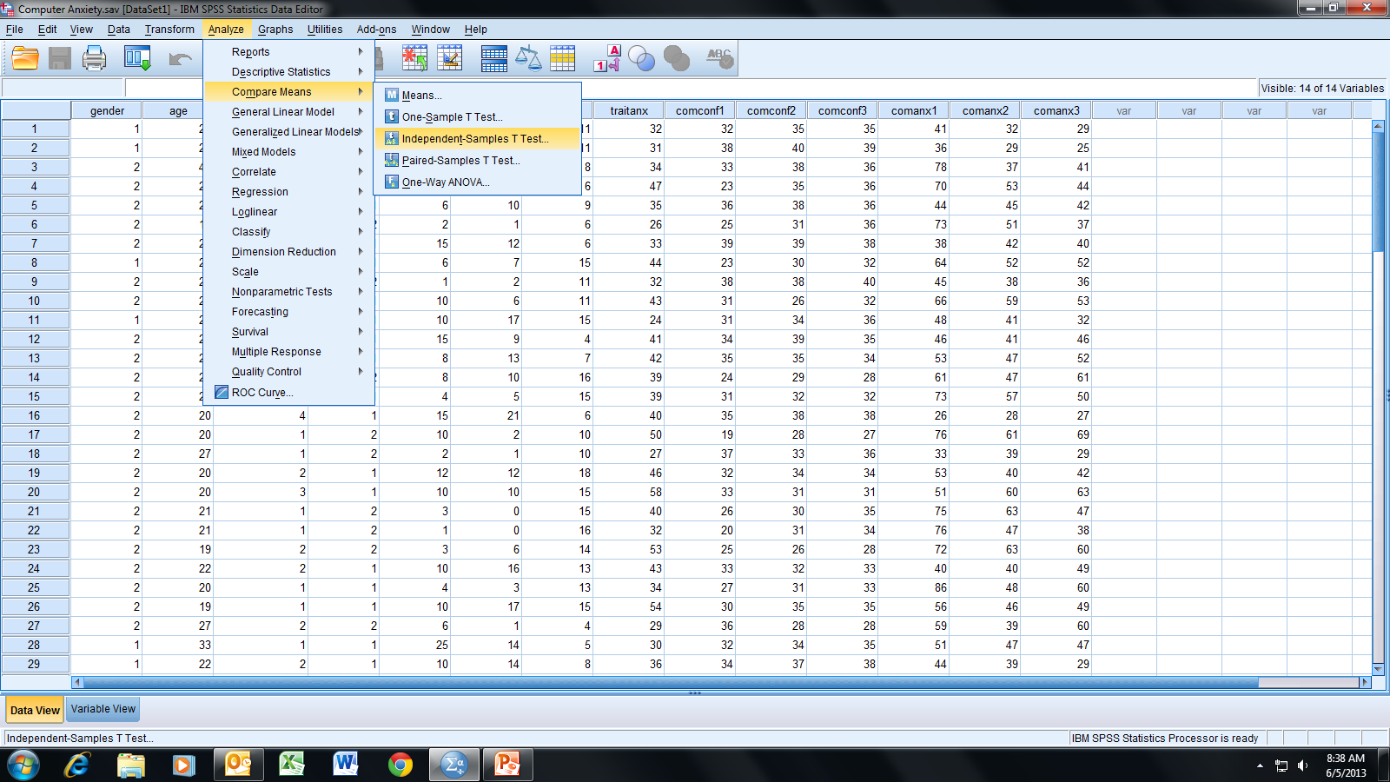
Follow the menu as indicated.

Slide 5
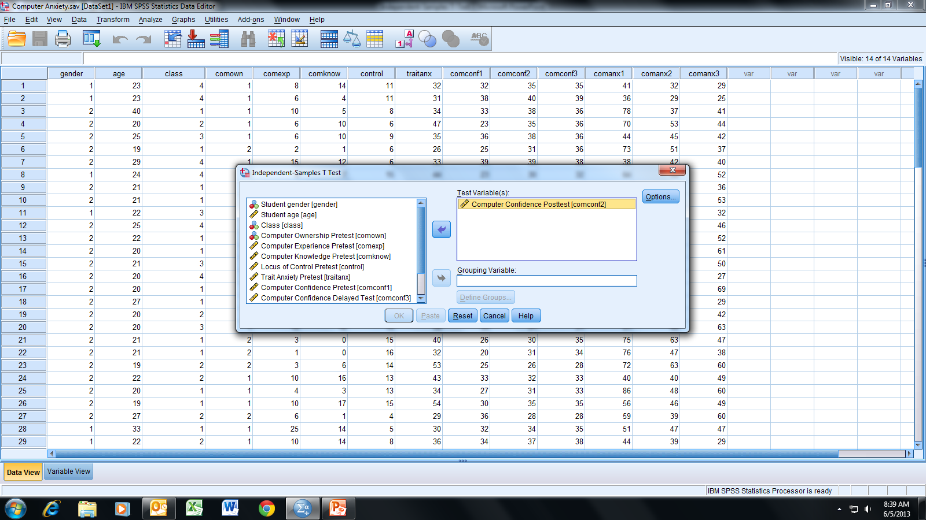
In this example, we will test the following null hypothesis:
H_{o}: There is no difference in mean computer confidence
posttest between male (group 1) and female (group 2)
University students (i.e., μ₁ = μ₂).
Select and move the Computer Confidence Posttest [comconf2]
variable to the Test Variable(s) box.

Slide 6
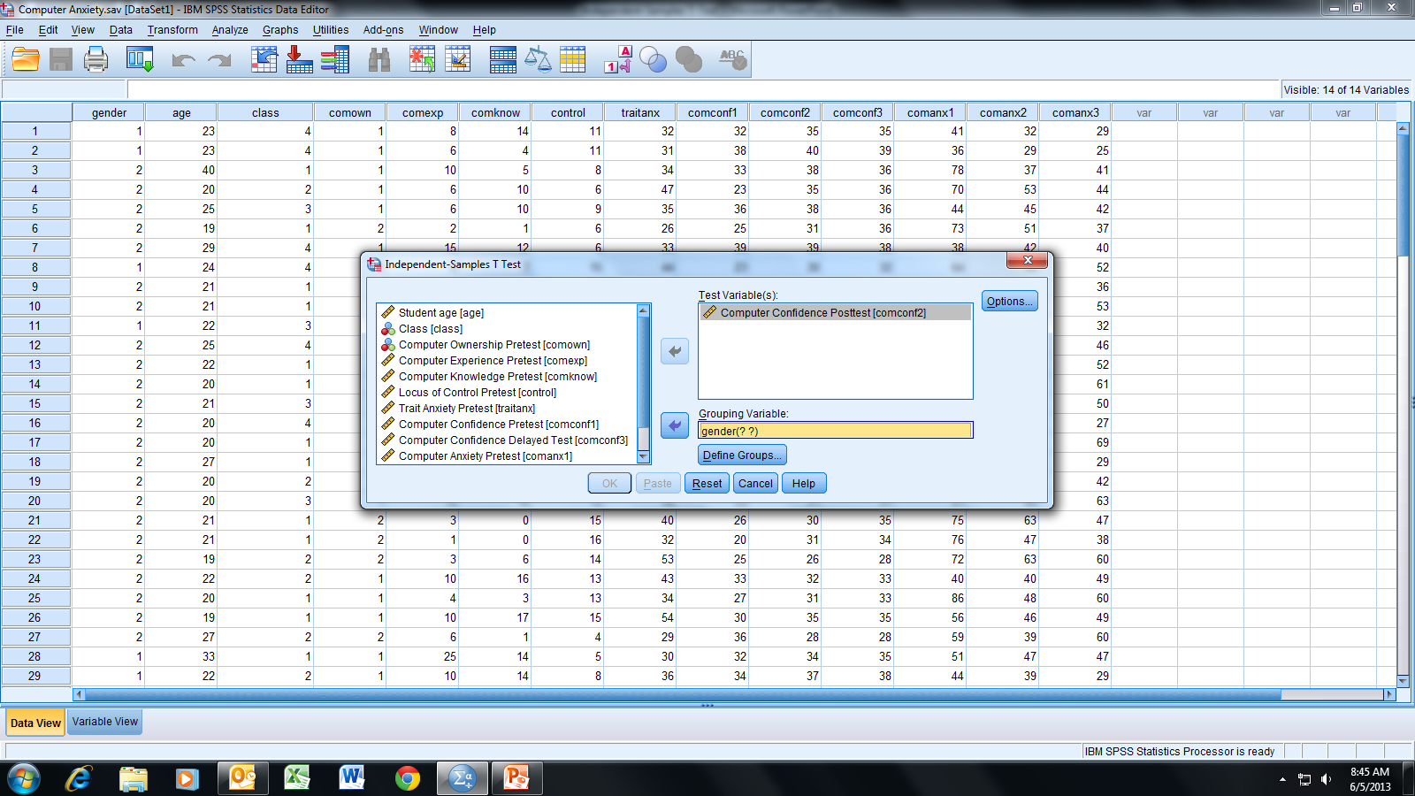
Select and move the gender variable to the
Grouping Variable box; click Define Groups.

Slide 7
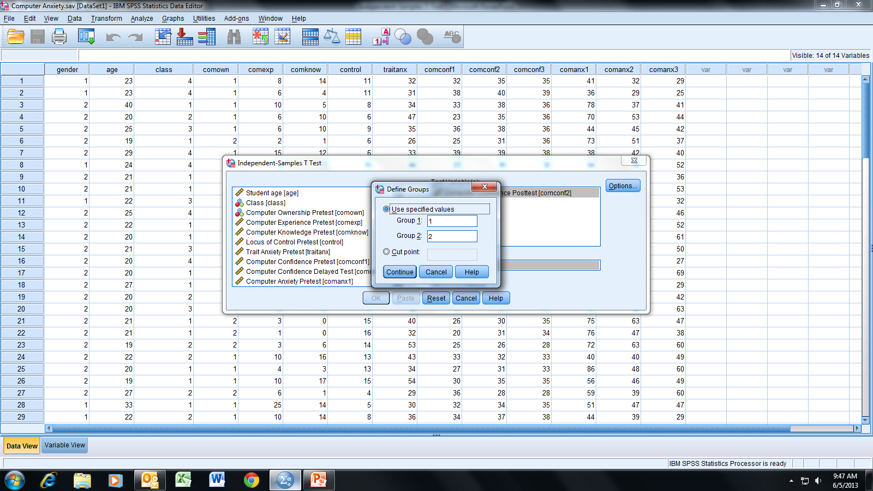
For Group 1 and 2 boxes, enter the gender variable
values 1 and 2, respectively; click Continue.

Slide 8
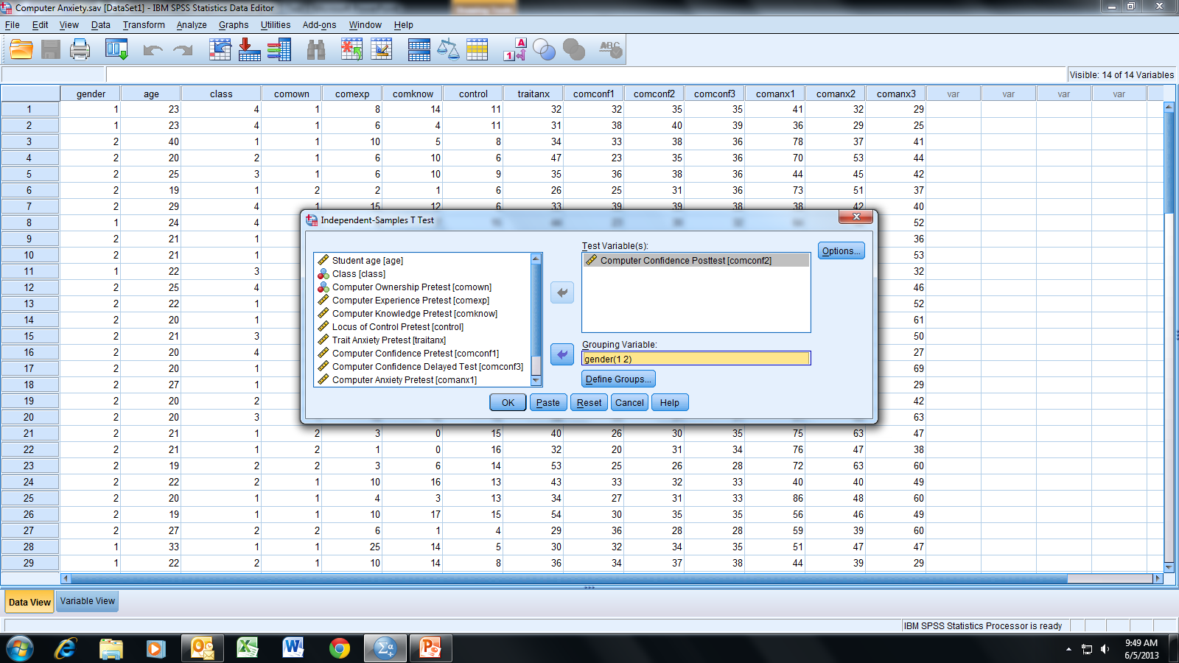
Click OK.

Slide 9
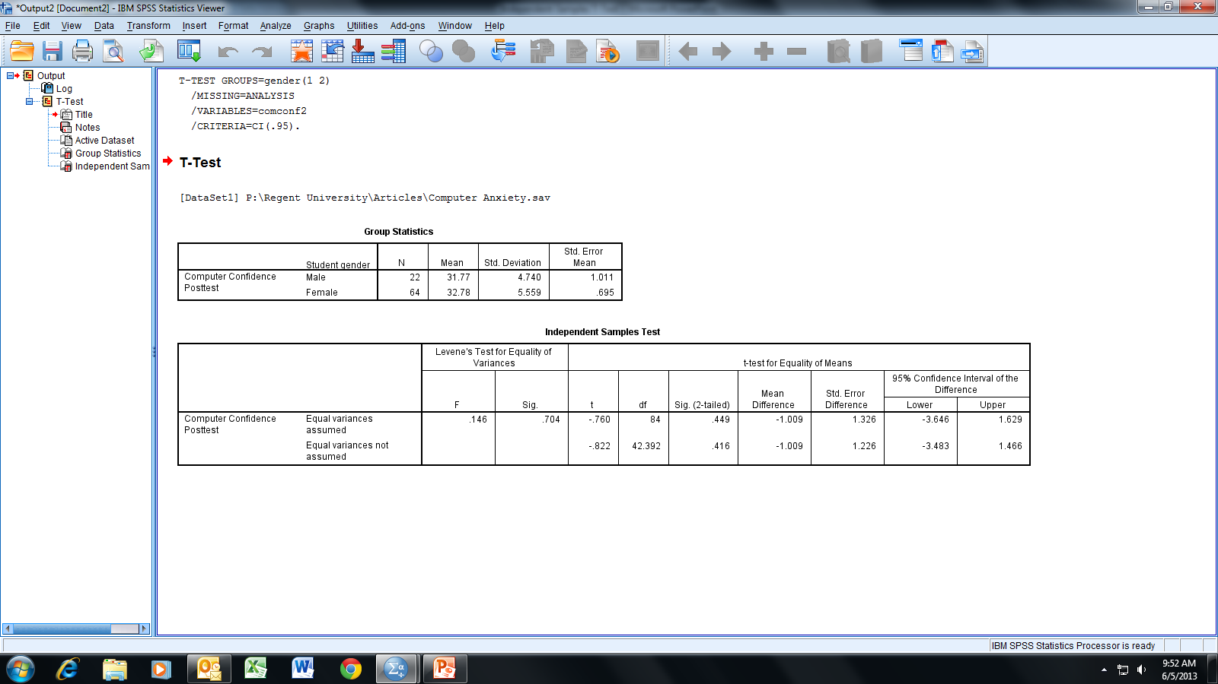
SPSS performs two t-tests: one assuming equal
variances between the two groups and one not
assuming equal variances. To determine which
t-test to use, we must perform an intermediate
hypothesis test.

Slide 10
We need to test the following null hypothesis using the
Levene’s Test: H_{o}: σ₁² = σ₂²; that is, the variance in group
1 (males) is equal to the variance in group 2 (females).
For α = .05, we see that the significance value of .704 is
greater than α; therefore, we fail to reject the above H_{o}
and can assume equal variances.
Thus, we will use the t-test in the top line of the
output table.

Slide 11
For the independent-samples t-test we are testing the null hypothesis
H_{o}: μ₁ = μ₂ in which the subscripts 1 and 2 correspond to groups 1 and 2,
respectively (i.e., the null hypothesis is that the mean of the variable
Computer Confidence Posttest is the same for both group populations).
We will choose α = .05 for a two-tailed test (i.e., we are interested if either
group mean is larger than the other). Note that the significance value of
.449 > α; therefore, we fail to reject H_{o} and conclude that there is no
difference between the two groups for the population mean of the
variable Computer Confidence Posttest.

Slide 12
CI₉₅ of the difference is approximately (-3.65, 1.63). This indicates
that we are 95% confident that the difference in the population
means for the variable Computer Confidence Posttest between
the two groups is in the range -3.65 to 1.63.
Note that the difference is calculated by group 1 - group 2 as
defined in the “Define Groups” window (see slide 7); that is,
we are 95% confident that -3.65 <= μ₁ - μ₂ <= 1.63.

Slide 13
End of Presentation

